Slide 1
THE GRENOBLE STREET ART :
THE SHEEPEST

Slide 2
THE ARTIST :
From Echirolles at Grenoble
Approximately 30 years old
CHEAP = consumer society in witch we live
SHEEP = everyone follows fashion
Slogan : « Je suis ceux que je suis »
technical : collage

Slide 3
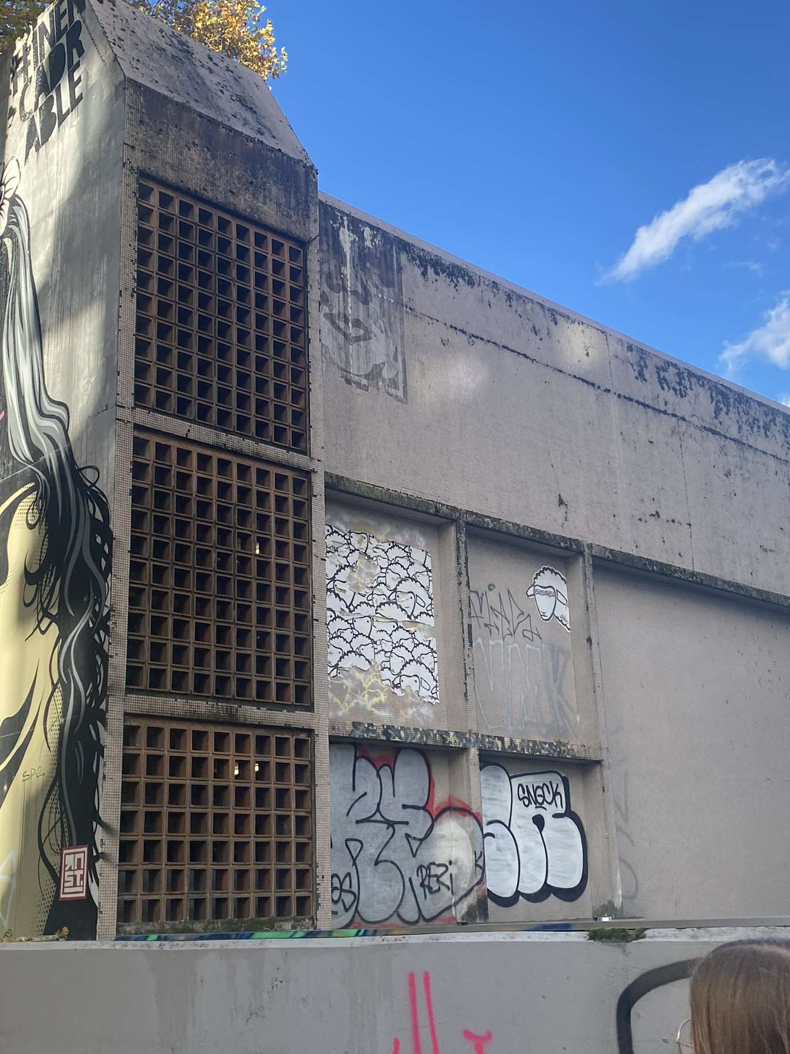
THE WORK THAT WE SEEN
We see some sheeps amount each others and seem to be following something.

Slide 4
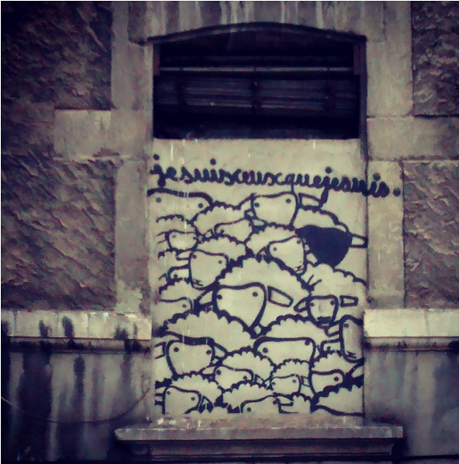
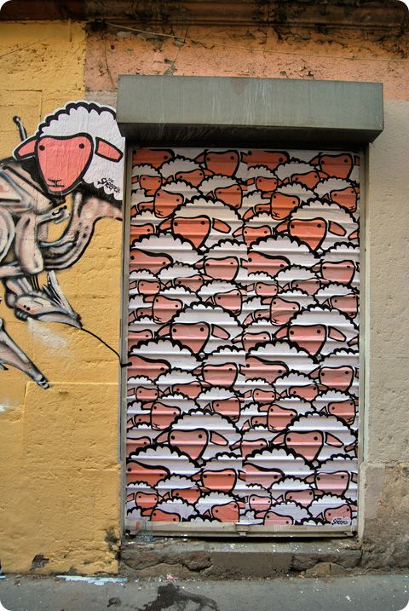
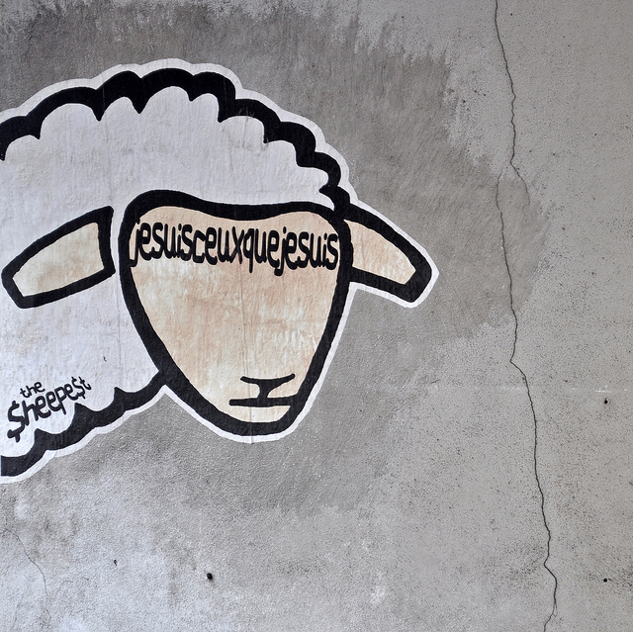
HIS WORKS

Slide 5
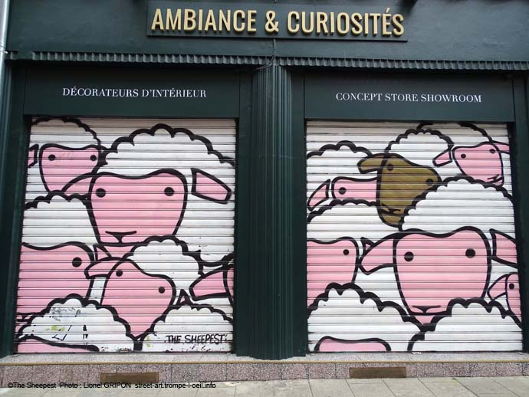

Slide 6
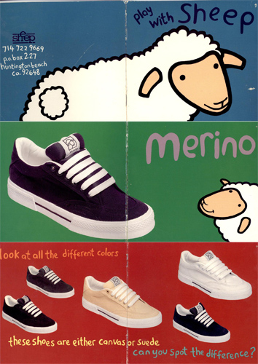
HIS INSPIRATION
(a shoes app)

