Slide 1
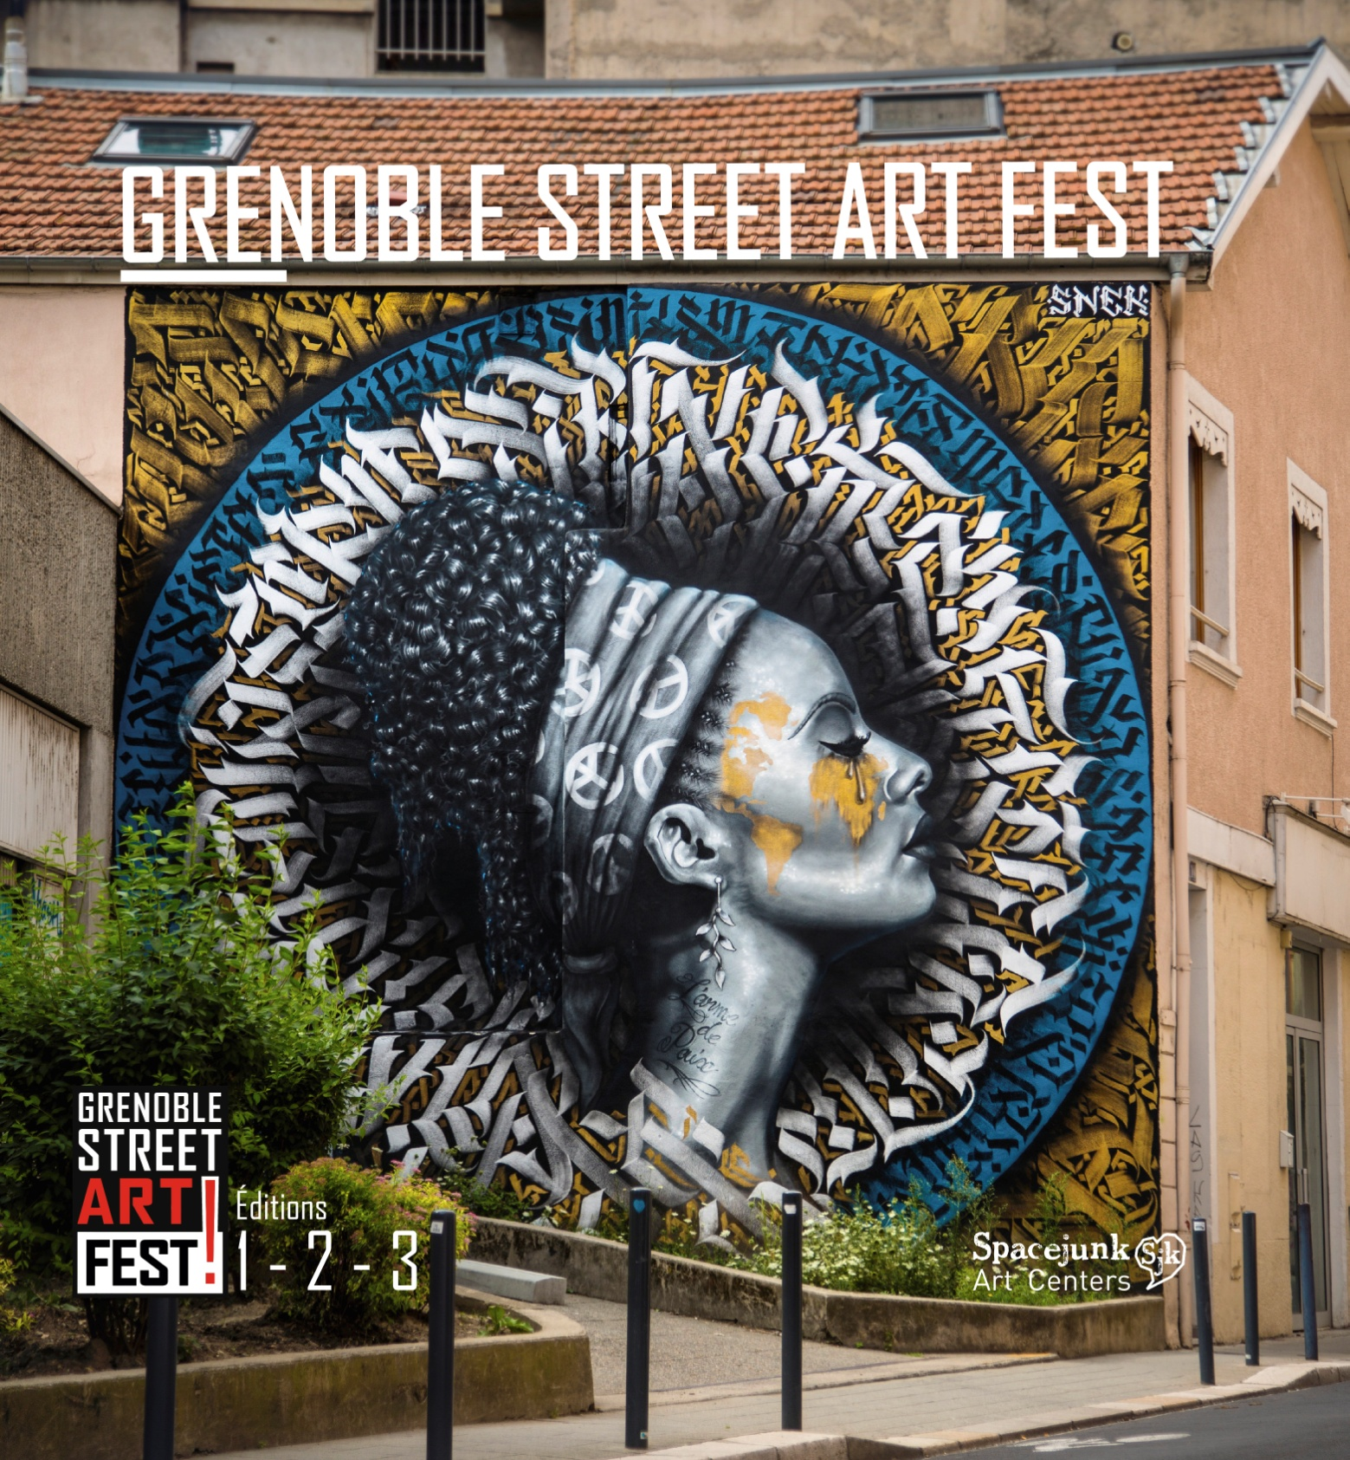
-

Slide 2

L’arme (larme) de paix by Snek
- Created in 2016
- At Grenoble in France
- For a street art festival

Slide 3
Snek is an artist from Grenoble who practices his art as well in France as in foreign countries. He was born in 1997.
- In the background, we can see different textures and shapes of different vibrant colors. There are different circles in different level.
The main thing about the piece is the woman in black and white with an headband with peace marks that maintains her afro haircut. She also has the world map with all the countries in yellow on her face.

Slide 4
The woman symbolizes peace in the world between indivduals.

Slide 5

Peace
Peace is a concept where everything is calm, it’s freedom from disturbance, a period in which there is no war or a war has ended.
Unfortunately, there is war going on in the world so we aren’t at peace.

