Slide 1
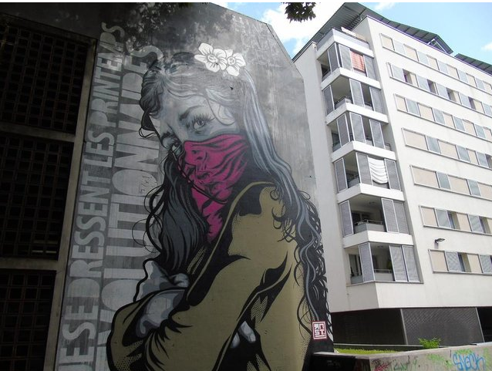
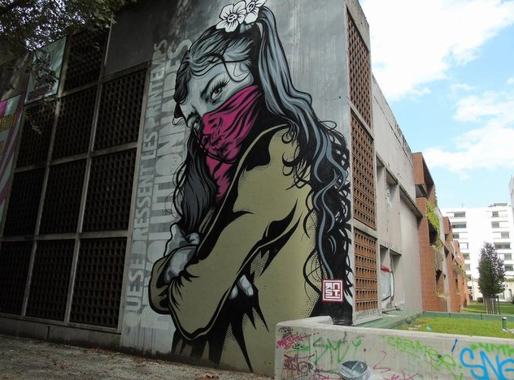
La fille de printemps by RNST

Slide 2
Piece
This street art was created for the Grenoble Street art Fest
In 2017
In the street François Raoult
On a wall of a parking for cars

Slide 3
RNST
The name of RNST is Ernest
He was born in 1972
He is French
He grew up in Dijon
He painted with stencil and poster

Slide 4
Descritpion
The graffiti shows us a tenage and rebel girl
The image is in white and black but she wears green jacket, a pink scarf and 2 white flowers on her head
She has a serious expression and we are able to see this through her face and crossed arms
On the left there is a texte: que se dressent les printemps révolutionnaires

Slide 5
Analyse
We choose this image because the little girl is beautiful and cute
The message is that the moments of the liberation of the people during the Arab spring
It’s a message of hope, the struggle continuous
It represents the revolution in general
The girl seems rebel and against the current system; in addition, the flowers she wears have a skull in the middle

