Slide 1
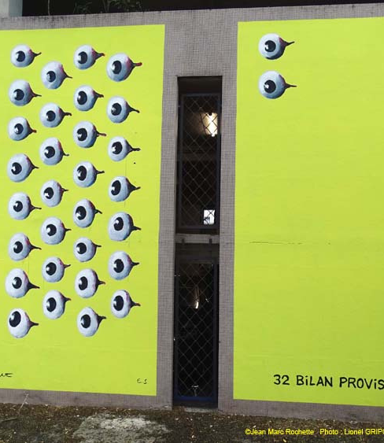
STREET ART
GRENOBLE
By Alix, Laia, Jana.R, Anaïs
2023

Slide 2

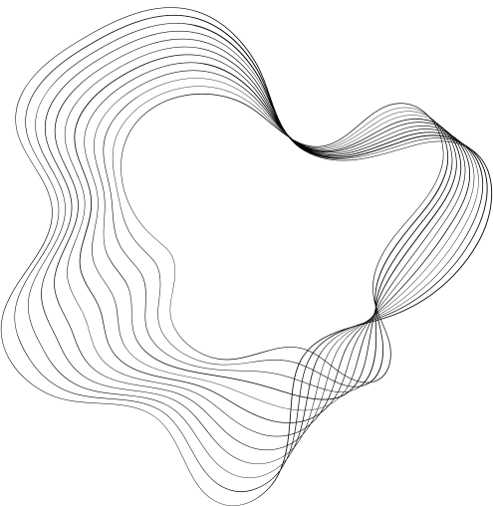
CONTENT
01
PRESENTATION
02
PAINTER
03
DESCRIPTION
04
ANALYSIS
05
OTHER TOPICS

Slide 3
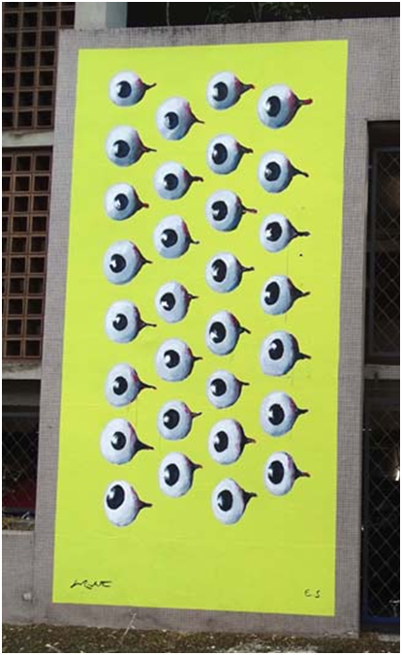
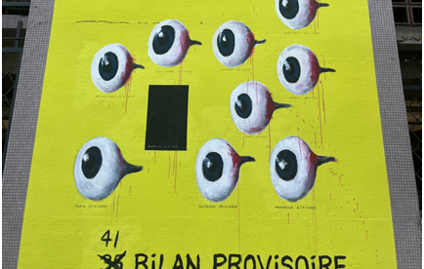
Street Photography
“32 Bilan Provisoire” / 2022-2023 / Grenoble
2023

Slide 4

Jean-Marc Rochette
2023

Slide 5
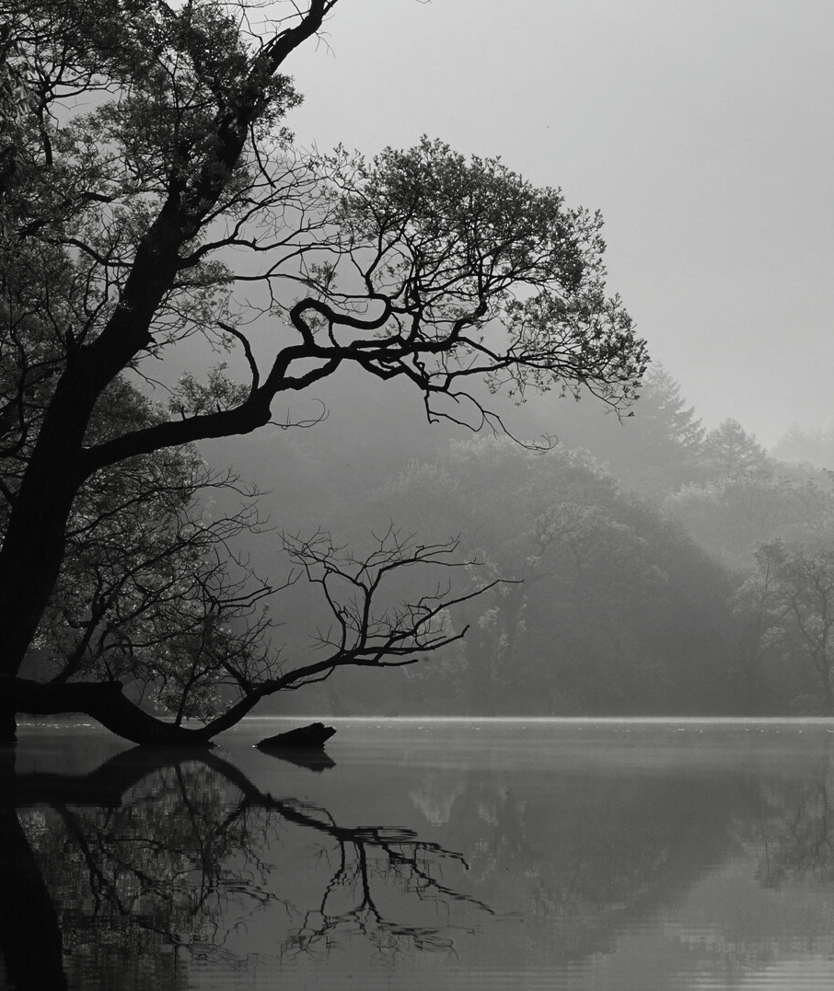
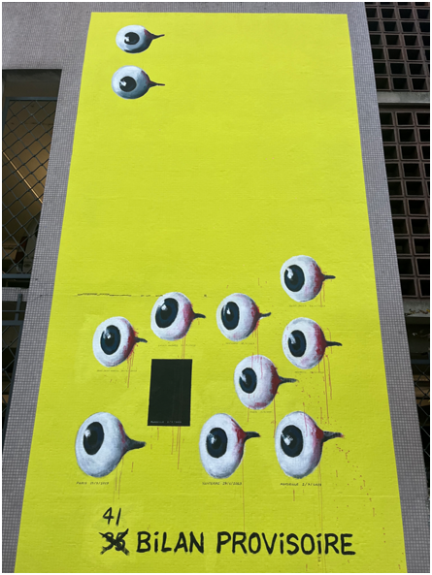
DESCRIPTION

Slide 6
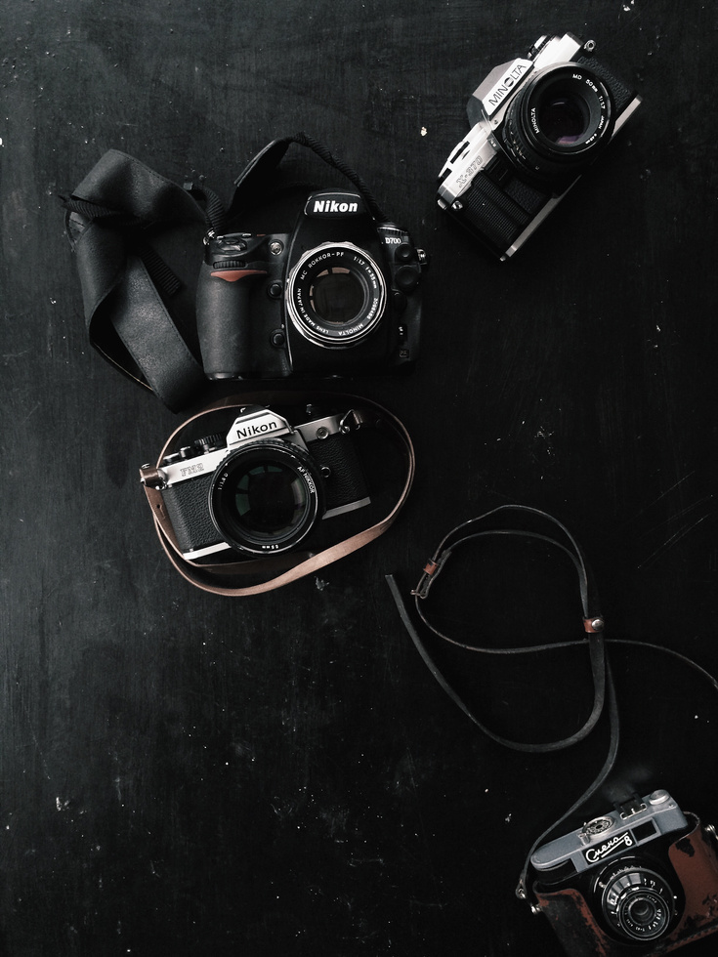
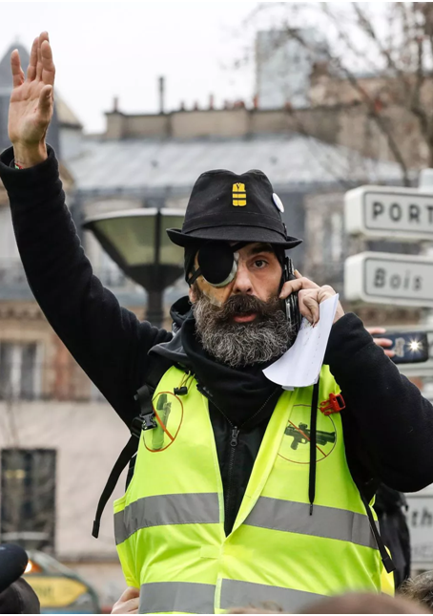
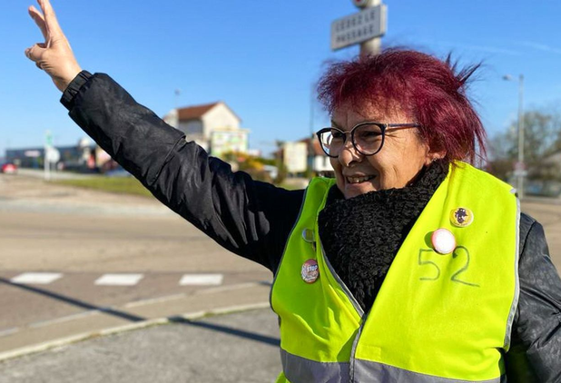
ANALYSIS
Yellow vest
2023

Slide 7
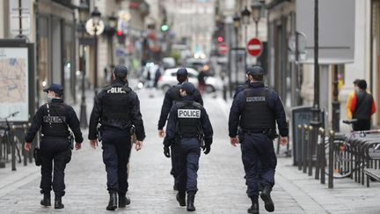
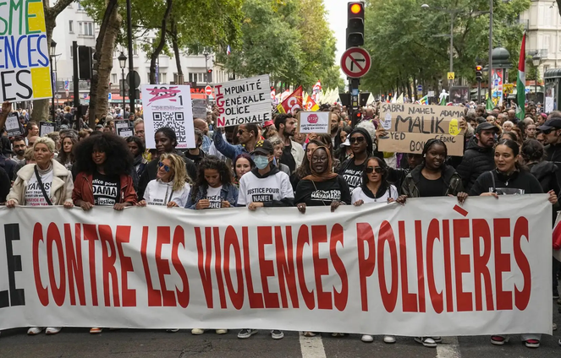
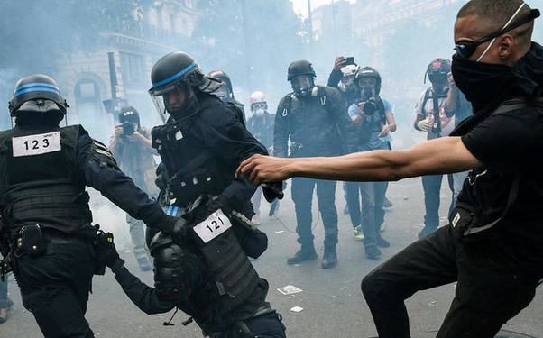
OTHER TOPICS
police violence
2023

Slide 8
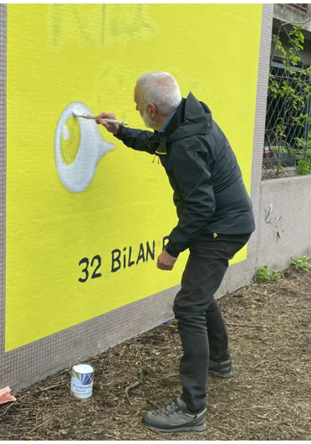
THANK YOU
FOR YOUR ATTENTION
2023

