Slide 1
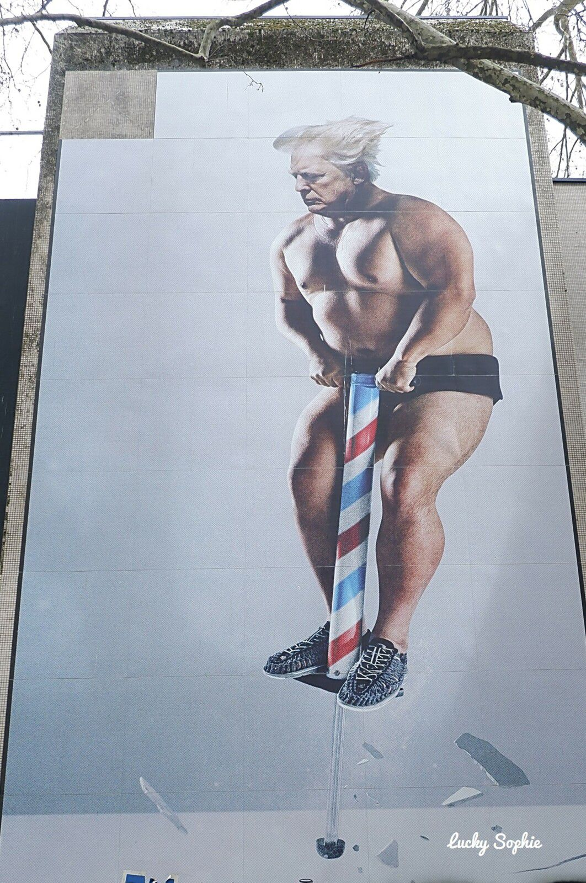
Presentation
Title: Our time in the universe
Beast
August 11 2022
10 Rue Hoche, 38000 Grenoble
It was done for the Grenoble Street Art Fest

Slide 2
Here is Donald Trump in briefs who’s jumping with a pogo stick and we see that he break something transparant who looks like ice.

Slide 3
Beast
Beast is the pseudonym for an anonymous Italy-based street artist. He has been very active on the streets of Europe and United States since 2009, with a focus on stencils at first and later at creating digital collages aiming to highlight political and social issues.

Slide 4
Description
In the lower corner we can see that he is wearing black and white sneakers,we can also see that he have an pogo stick in his hands and he is wearing only a short pants he have white hair in middle of the picture we can see donald trump without so much clothes doing maybe sport with the pogo stick
In the background there is a simple white wall
In the middle of this piece of art, there is donald trump in briefs who’s jumping on a pogo stick.
In the lower part of the art, there is ice broken because of Trump’s Jumps.

Slide 5
Detailed analysis
This piece of art denounce the fact that Donald Trump is destroying the ice floe represented by the broken glass.
In fact, USA is the world’s biggest polluter and the pollution increase the temperature which melts the pack ice.

Slide 6
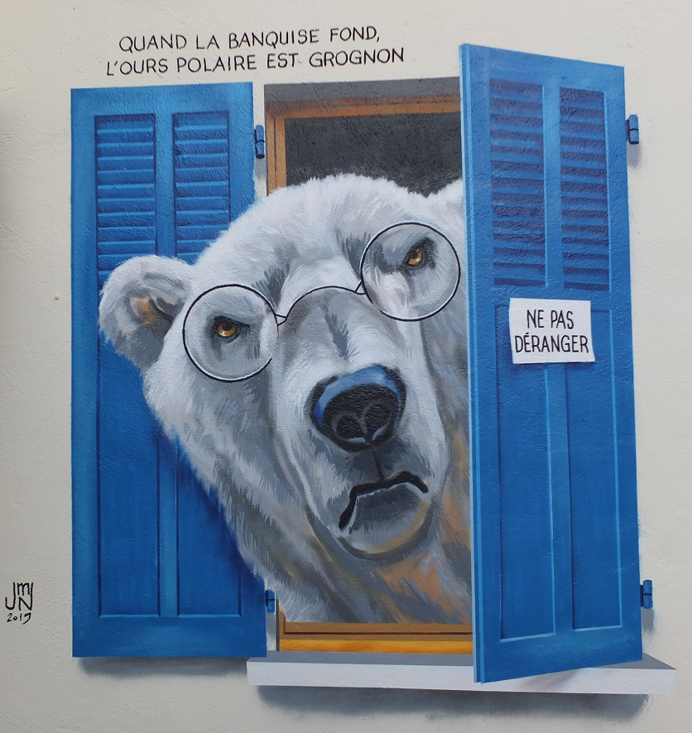
We think that this work is related to our work of art because we see that Trump is destroying the ice pack, which is the home of the polar bear.

